Slide 1
Digital Baseband Transmission
EE202
yanyan.wu@xjtlu.edu.cn
Department of Electronics and Electrical Engineering
Xi’an Jiaotong – Liverpool University

Slide 2
Contents
Sampling
Quantization
Encoding
Pulse shaping
Digital baseband communication vs. pass-band communication
PCM-TDM digital telephony

Slide 3



Formatting & transmission of baseband signal
Digital info.
Bit stream
(Data bits)
Pulse waveforms
(baseband signals)
source
Digital
Modulation
Pulse
shaping
Analog
info.
Sample
Quantize
Encode
Sampling at rate
(sampling time=Ts)
Encoding each q. value to
bits
(Data bit duration Tb=Ts/l)
Quantizing each sampled
value to one of the
L levels in quantizer.
Mapping every bits to a
symbol out of M symbols (digital modulation)
and transmitting a baseband waveform
within duration T_{s}.

Slide 4
Sampling
Analogue signals that are continuous in time and amplitude require exclusive use of a communication system resource for the duration of transmission ☹
Redundancy: values of such signals at 2 sufficiently close instants of time are usually related in some way ☺
Sampling: the process of taking only a few values of an anlogue signal at regular time intervals.
Reconstruction: provided the Sampling Theorem is followed, the original signal can be perfectly reconstructed from these samples ☺

Slide 5
How many samples per second?
One of the key goals in waveform sampling is to digitize only the minimum number of samples necessary to represent the waveform accurately and hence allow accurate reconstruction on reception.
The minimum rate at which an arbitrary waveform can be sampled without loss of information is twice the bandwidth of the input waveform. This is known as the Nyquist sampling criterion.
  Sampling at less than this rate results in distortion referred to as aliasing.
  Sampling at much higher than this rate results in redundancy and low bandwidth efficiency.

Slide 6
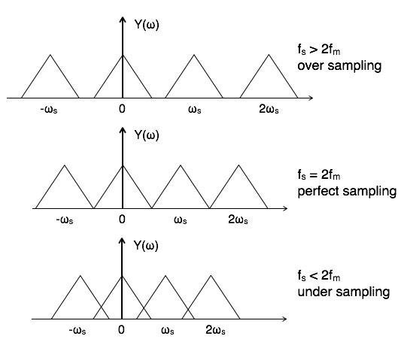
Critical Sampling

Slide 7
Anti-Aliasing Filter
Most signals are not band-limited
Use low-pass filter before (pre-filtering) or after (post-filtering) sampling to limit bandwidth : anti-aliasing
Realisable filters require non-zero transition bandwidth between pass-band and stop-band
Filter cost rises sharply with less transition bandwidth

Slide 8
Nyquist sampling theorem – aliasing
If the Nyquist sampling criterion is not met, perfect reconstruction of the original signal is not achieved.
When sampling at this minimum rate requires a 'brick wall' filter for signal recovery after D/A conversion. In practice, a sampling rate of at least three times the maximum sampling frequency is used in order to allow simple and cost-effective recovery filters.

Slide 9



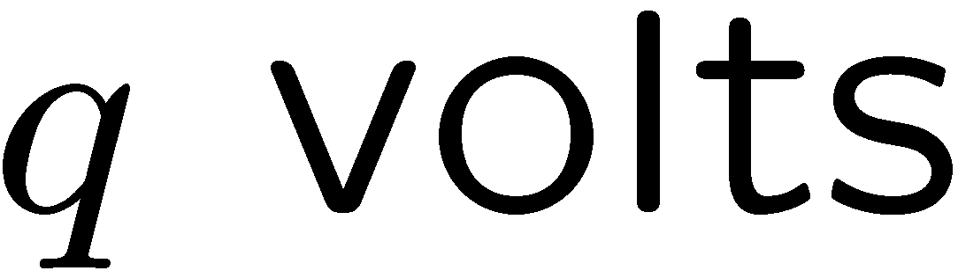
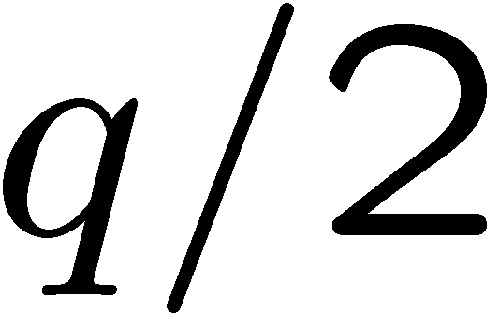

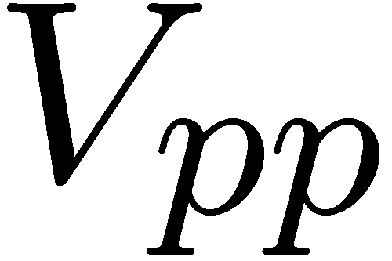
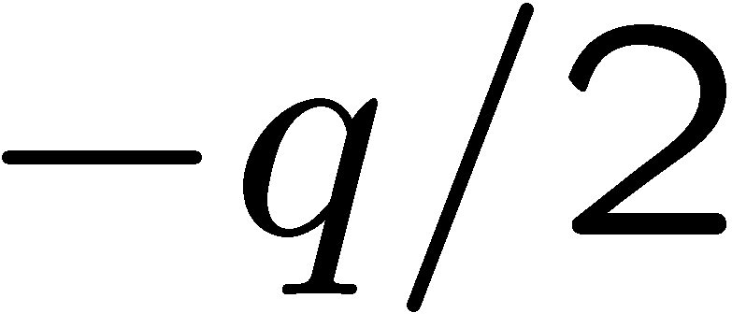
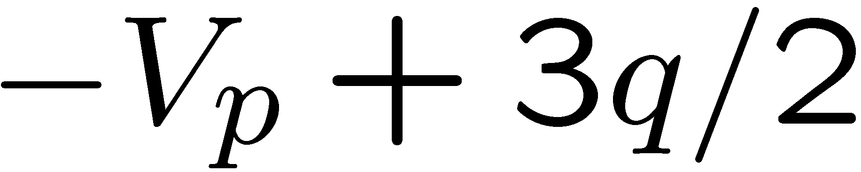
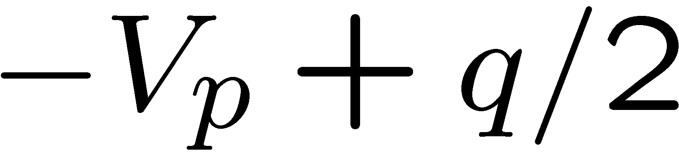
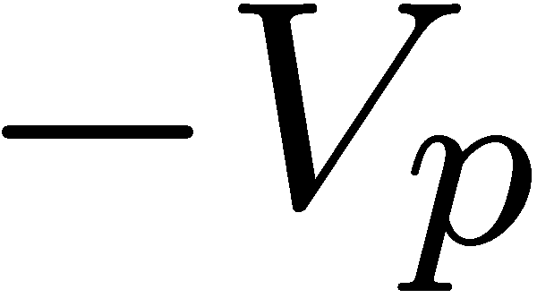
Digitisation
Remember: the samples are still analogue.
Digitisation: sampling + quantisation
Quantising: Mapping samples of a continuous amplitude waveform to a finite set of amplitudes.
Out
Quantized
values
In

Slide 10
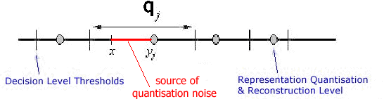
… or more formally:
Given amplitude x, divide domain of x into non-overlapping quantile intervals q_{j}:
If x falls in q_{j} then it is represented by y_{j}.
Quantization introduces coding errors : quantisation noise

Slide 11
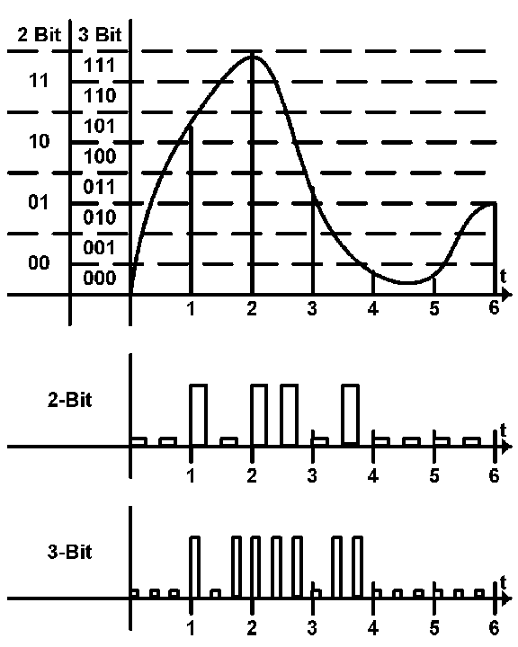
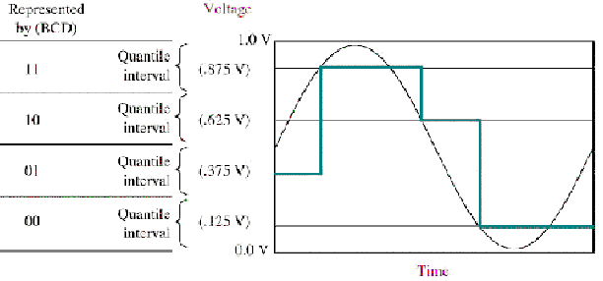
Quantiser resolution
Quantisation noise is reduced as L increases. Data rate (and hence bandwidth) increases.

Slide 12
Pulse Modulation
Pulse modulation consists essentially of sampling analog information signals and then converting those samples into discrete pulses and transporting the pulses from a source to a destination over a physical transmission medium.
The four predominant methods of pulse modulation:
  pulse width modulation (PWM)
  pulse position modulation (PPM)
  pulse amplitude modulation (PAM)
  pulse code modulation (PCM)

Slide 13
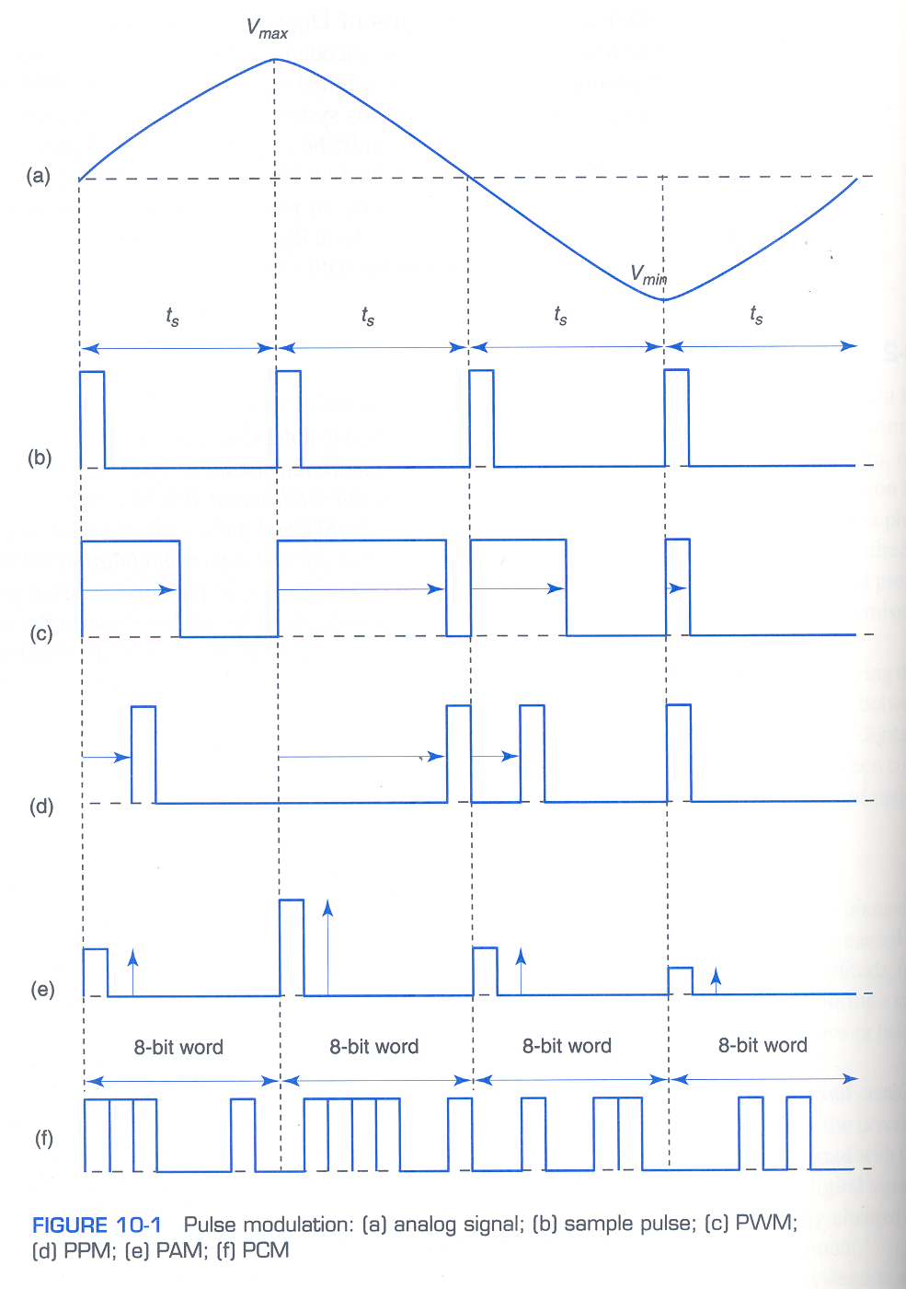

Slide 14
Pulse Code Modulation
With PCM, the analog signal is sampled and then converted to a serial n-bit binary code for transmission.
Each code has the same number of bits and requires the same length of time for transmission

Slide 15
Pulse Code Modulation
PCM is a binary system where a pulse or lack of a pulse within a prescribed time slot represents either a logic 1 or a logic 0 condition.
PCM is the preferred method of communications within the public switched telephone network because with PCM it is easy to combine digitised voice and digital data into a single, high-speed digital signal and propagate it over either metallic or optical fiber cables.
The term pulse code modulation is somewhat of a misnomer, as it is not really a type of modulation but rather a form of digitally coding analog signals.
With PCM, the pulses are of fixed length and fixed amplitude.

Slide 16
Digital baseband transmission Vs bandpass transmission
In both digital baseband and band pass communications, the digital symbols are transformed into waveforms that are compatible with the characteristics of the channel.
In baseband communication, these waveforms take the form of shaped pulses.
In band-pass communication, the shaped pulse modulated a sinusoid carrier for propagation to the desired destination.

Slide 17
ISI – Inter-symbol Interference
t
t
LowPass
Filter
Fourier
Transform
Fourier
Transform
f
f
Tb
2Tb
5Tb
6Tb
t
3Tb
4Tb

Slide 18
The baseband communication
HT(f)
Hc(f)
Pulse Shaping
channel
+
Channel noise n(t)
+
Pulse Match
HR(f)

Slide 19
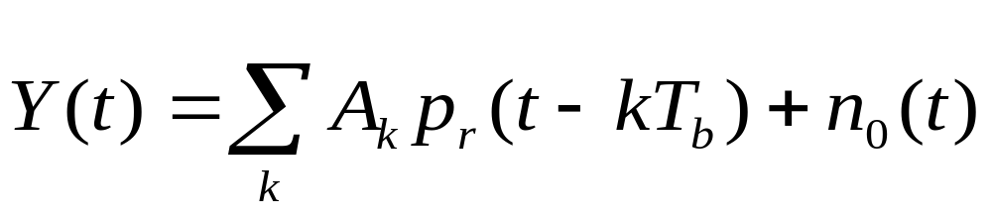
Explanation of Pr(t)
HT(f)
Hc(f)
HR(f)
Pg(t)
Pr(t)
Trans
filter
channel
Receiver
filter
ISI - Inter Symbol
Interference

Slide 20
Explanation of ISI
HT(f)
Hc(f)
HR(f)
Pr(t)
Pg(t)
Trans
filter
channel
Receiver
filter
HT(f) Hc(f) HR(f)
Pg(f)
Pr(f)

Slide 21
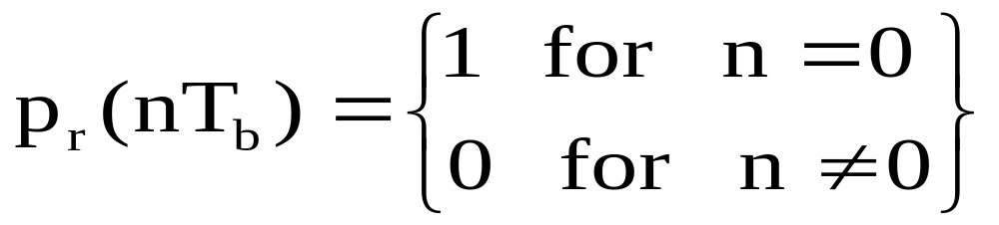
5.2.1 Baseband pulse shaping
The ISI can be eliminated by proper choice of received pulse shape pr (t).
Not uniquely specify Pr(t) for all values of t.

Slide 22
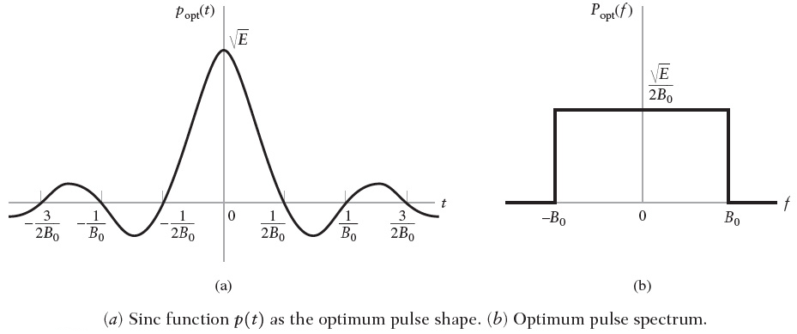
The condition for removal of ISI given in the theorem is called
Nyquist (Pulse Shaping) Criterion

Slide 23
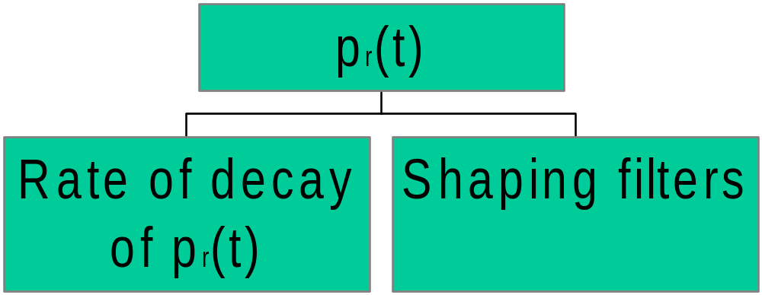
Particular choice of Pr(t) for a
given application
The smallest values near Tb, 2Tb, …
In such that timing error (Jitter)
will not Cause large ISI
Shape of Pr(f) determines the ease
with which shaping filters can be
realized.

Slide 24
A Pr(f) with a smooth roll - off characteristics is preferable
over one with arbitrarily sharp cut off characteristics.
Pr(f)
Pr(f)

Slide 25
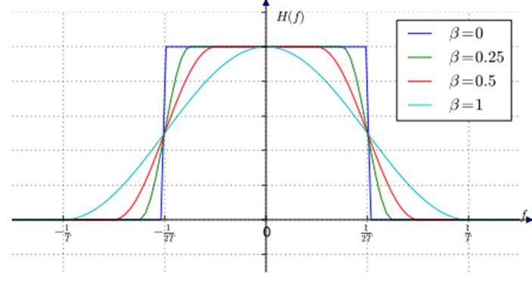

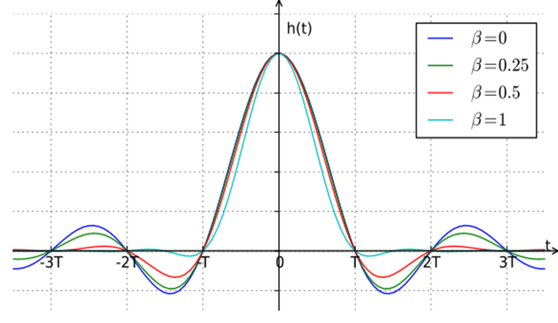
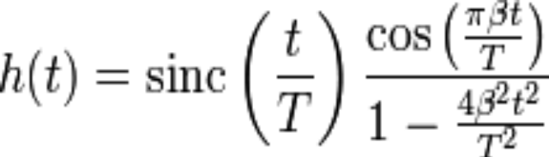
Its frequency-domain description is a piecewise function, given by:
Raised Cosine Pulse Spectrum

Slide 26
Overview
The BW occupied by the pulse spectrum is B= (1+ β) Rb/2.
For a baseband transmission, the minimum BW is Rb/2 and the maximum BW is Rb.
(What about for a band pass transmission ?)
Larger values of β imply that more bandwidth is required for a
given bit rate, however this leads for faster decaying pulses, which means that time synchronization will be less critical and will not cause large ISI.

Slide 27
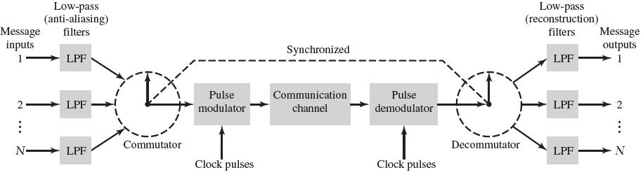
Digital telephony: PCM-TDM
http://computer.howstuffworks.com/question372.htm

